Slide 1
The impact of COVID-19 on pasture use in Uzbekistan
Professor Tulkin Farmanov, Ministry of Agriculture
Post Doc Rustam Muradov, UNDP Uzbekistan
Tashkent, Uzbekistan

Slide 2
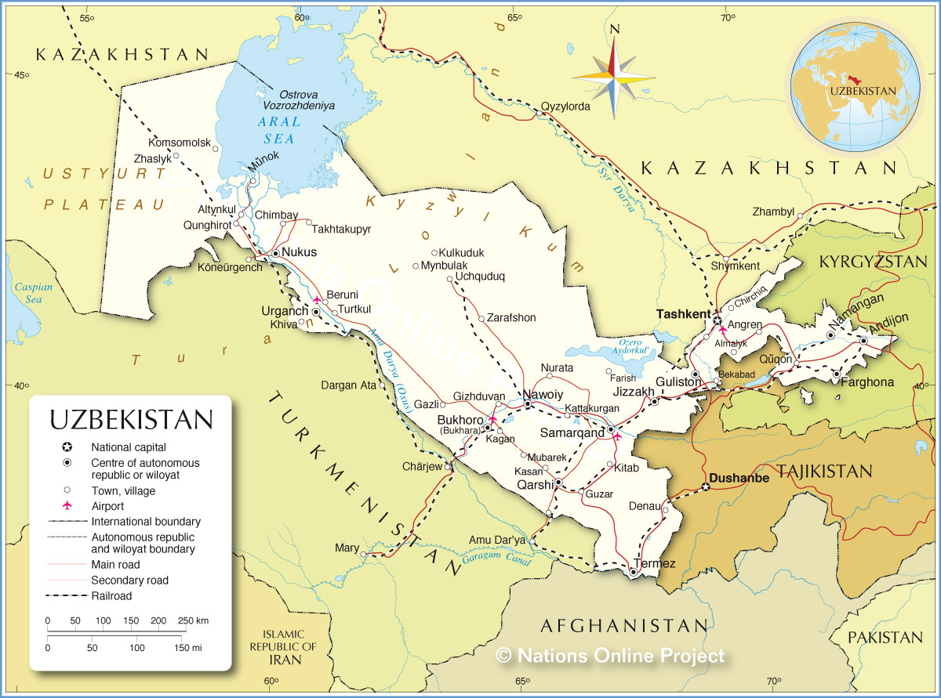
Brief information on pasture use
The area of pastures and hayfields is about 21.1 million hectares, or 46.5% of the entire territory of Uzbekistan, where about 2.5 million people live
The livestock main part - up to 87% of the total livestock in the Republic belongs to private households, but they do not have pasture land in constant use.
Cattle grazing is concentrated and haphazard around settlements, pasture use is free and illegitimate, pastures of other business entities are often used.

Slide 3
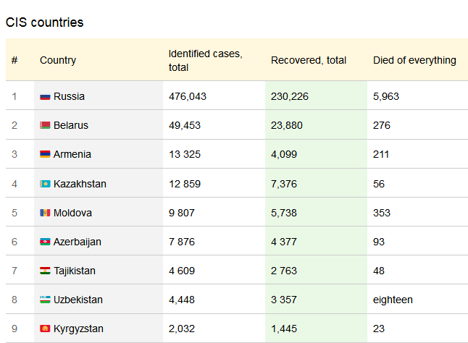
COVID-19 in Uzbekistan
The first coronavirus infection in Uzbekistan was detected on March 15. In the regions of Uzbekistan where infections have been identified, emergency measures have been introduced to prevent the spread of infection.
The greatest spread of the virus is observed in the capital, regional centers and among a group of people who arrived on a charter flight to their homeland from other countries of the world;
Restriction of transport between regions and districts, as well as in Tashkent, with the exception of food products (agricultural food products, etc.) to the capital and regional centers;
Full isolation of labor migrants arriving from foreign countries.

Slide 4
COVID-19 and pasture use
Scientific support of pasture events - in connection with isolation / quarantine of the trip of scientists - employees of the research institute for pasture use, geobotanic, animal husbandry, etc. in pasture areas temporarily suspended (March-June) , there were problems with conducting geobotanical surveys, drawing up grazing plans, etc.
Restoration of pasture vegetation - the construction of fencing of pasture crop nurseries, along with the provision of seeds for highly productive pasture crops, is being delayed. A decrease in activity in the repair and reconstruction of water pipelines, other pasture infrastructure .
The provision of fodder is a relatively rainy spring of 2020, which contributed to an increase in the yield of pasture natural fodder plants , so there is no feed shortage for areas with traditional animal husbandry . The gradual removal of quarantine will allow shepherds to migrate from pasture to irrigated areas to graze livestock on grain fields.
In connection with the increase in unforeseen types of costs in the country's budget, the Government is forced to review budget revenues and expenses, and reduce some types of costs, for example, the construction of new wells / boreholes, drilling and other significant socio-economic measures.

Slide 5
Conclusions
The government is using economic leverage to reduce the impact of quarantine on the socio-economic situation of not only the activities of business entities, but also of every citizen of the country;
Pasture business entities are offered various loans for the purchase of machinery, production of products for export , loan repayment periods are repaid or extended;
Practical assistance was provided to vulnerable segments of the population through targeted transfers of funds, food, etc .;
Practical assistance was provided for exporting products, modernizing production, etc.
The purpose of the provision of aid - Support for businesses and every citizen in this difficult situation; the population is not infected with the virus; all families remained at home in the pasture territory; to prevent the deterioration of the socio-economic situation of grazing livestock and grazing villages in general.

